Slide 1

Inspired by Apple Inc.
Submitted by Abin Antony P J
Notes:
Next project presentation on the Apple iPhone Sales and Rating Analysis Dashboard.
This project showcases how we can utilize Tableau, a powerful and advanced visualization tool similar to Power BI.
to analyze and visualize iPhone sales performance and customer ratings.
My goal is to transform raw data into actionable insights that drive strategic decision-making.

Slide 2
iPhone
iPhone
iPhone
Notes:
Next project presentation on the Apple iPhone Sales and Rating Analysis Dashboard.
This project showcases how we can utilize Tableau, a powerful and advanced visualization tool similar to Power BI.
to analyze and visualize iPhone sales performance and customer ratings.
My goal is to transform raw data into actionable insights that drive strategic decision-making.

Slide 3
iPhone
iPhone
introducing
iPhone
Notes:
Next project presentation on the Apple iPhone Sales and Rating Analysis Dashboard.
This project showcases how we can utilize Tableau, a powerful and advanced visualization tool similar to Power BI.
to analyze and visualize iPhone sales performance and customer ratings.
My goal is to transform raw data into actionable insights that drive strategic decision-making.

Slide 4
iPhone
iPhone
iPhone
Sales and Rating Analysis
iPhone
iPhone
Notes:
Next project presentation on the Apple iPhone Sales and Rating Analysis Dashboard.
This project showcases how we can utilize Tableau, a powerful and advanced visualization tool similar to Power BI.
to analyze and visualize iPhone sales performance and customer ratings.
My goal is to transform raw data into actionable insights that drive strategic decision-making.

Slide 5
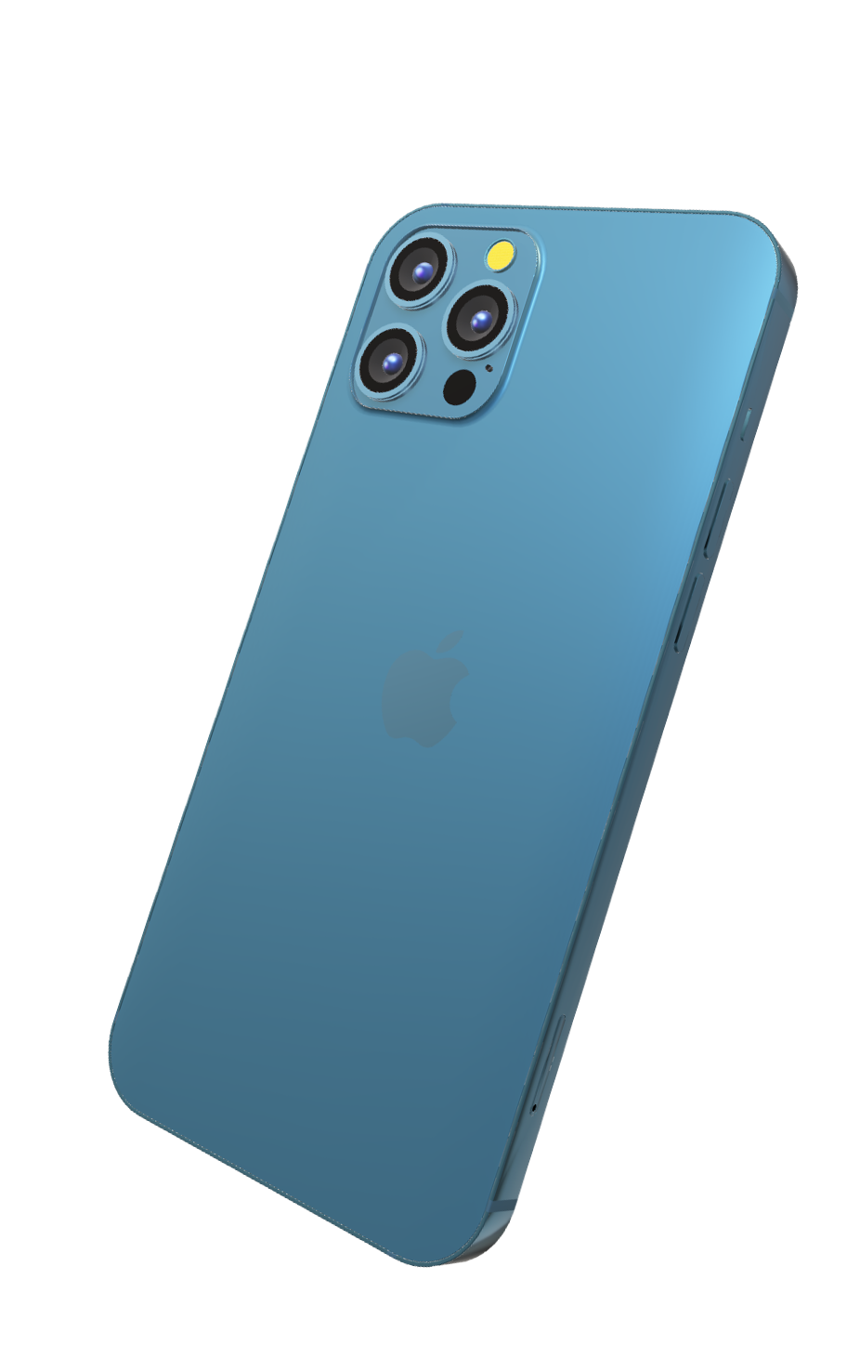
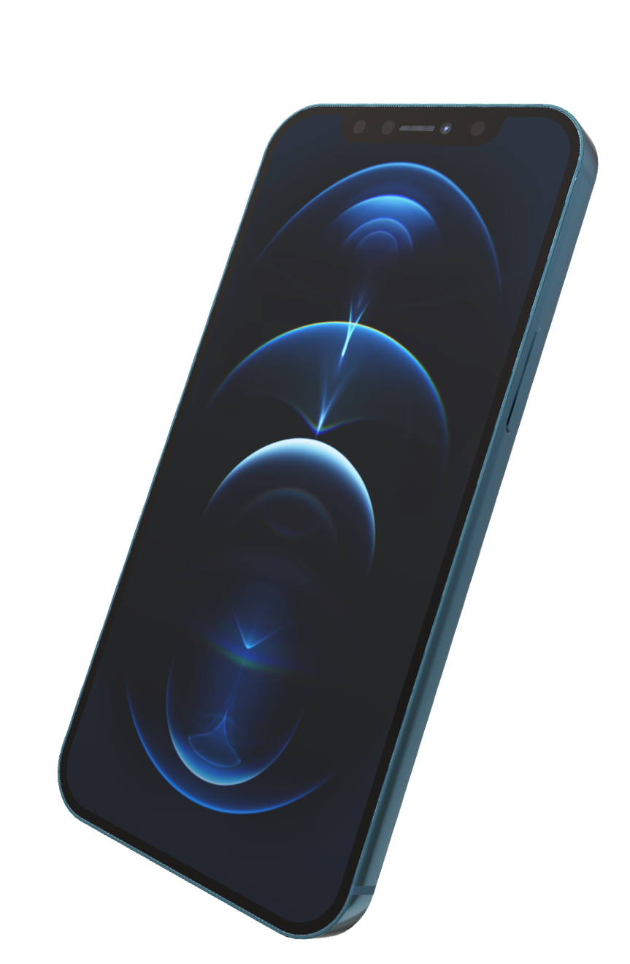
Introduction
Apple Inc. revolutionized the global market with its innovative iPhone lineup. Notable models like the iPhone SE, XS, XR, 11, and 12 series, including the 2020 iPhone 12 Pro Max, showcased groundbreaking advancements. This commitment to quality bolstered Apple's dominance in Europe and solidified its position as the world's second-largest smartphone manufacturer.
Notes:
Apple: Global tech leader.
iPhone Line-up: Innovative.
2020: Released iPhone 12 Pro Max.
Product Expansion: Ongoing.
Original iPhone: Released 2007.
Notable Models: SE, XS, XR, 11, 12 series.
Advancements: Cameras, processors.
Commitment: Quality.
Market Strength: Dominance in Europe.
Market Position: Second-largest smartphone manufacturer.

Slide 6
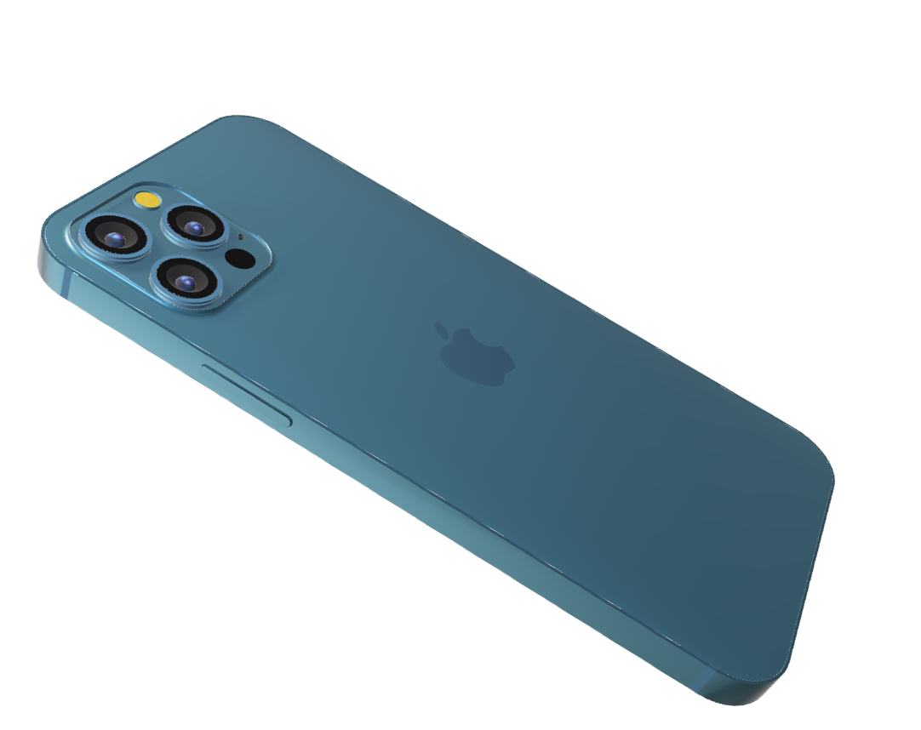
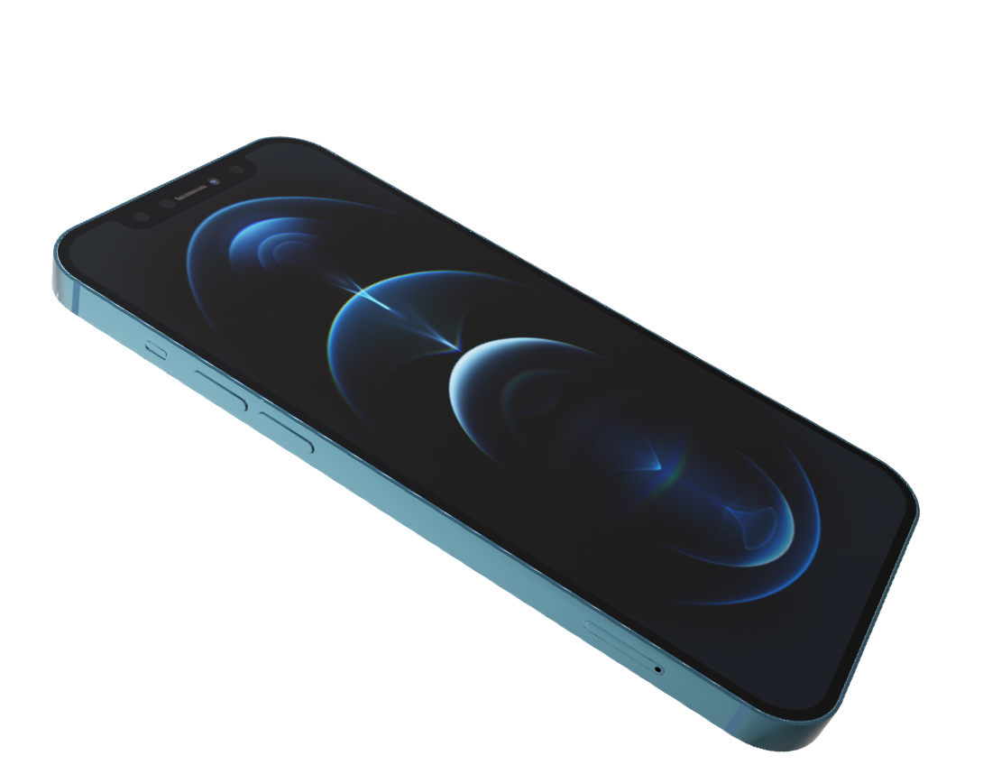
Dataset

Slide 7
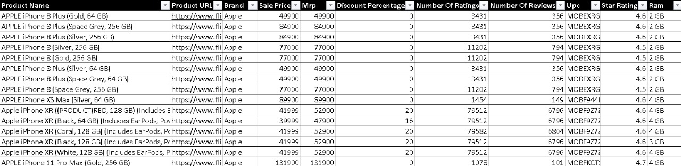
Dataset
Notes:
Glimpse of the dataset in structured format :
Total Entries : 63
Total columns : 11

Slide 8
Key Details
TOTAL ENTRIES : The dataset contains 63 entries
COLUMNS : There are 11 columns in the dataset.
PRODUCT NAME : The name of the model.
BRAND : The manufacturer of the product
MRP : Maximum Retail price of the model.
PRODUCT URL : The web link of the product page.
SALE PRICE : The current selling price of the model.
DISCOUNT % : The percentage reduction from the MRP.
Notes:
Total Entries : 63
Total columns : 11

Slide 9
Key Details
NUMBER OF RATINGS : Total count of ratings given
by the customers.
NUMBER OF REVIEWS : The total number of written
reviews by customers.
UPC : The Universal Product Code, a unique identifier for
the product.
STAR RATING : The average rating based on customer feedback.
RAM : Random Access Memory, The amount of memory in the product.
Notes:
Total Entries : 63
Total columns : 11

Slide 10
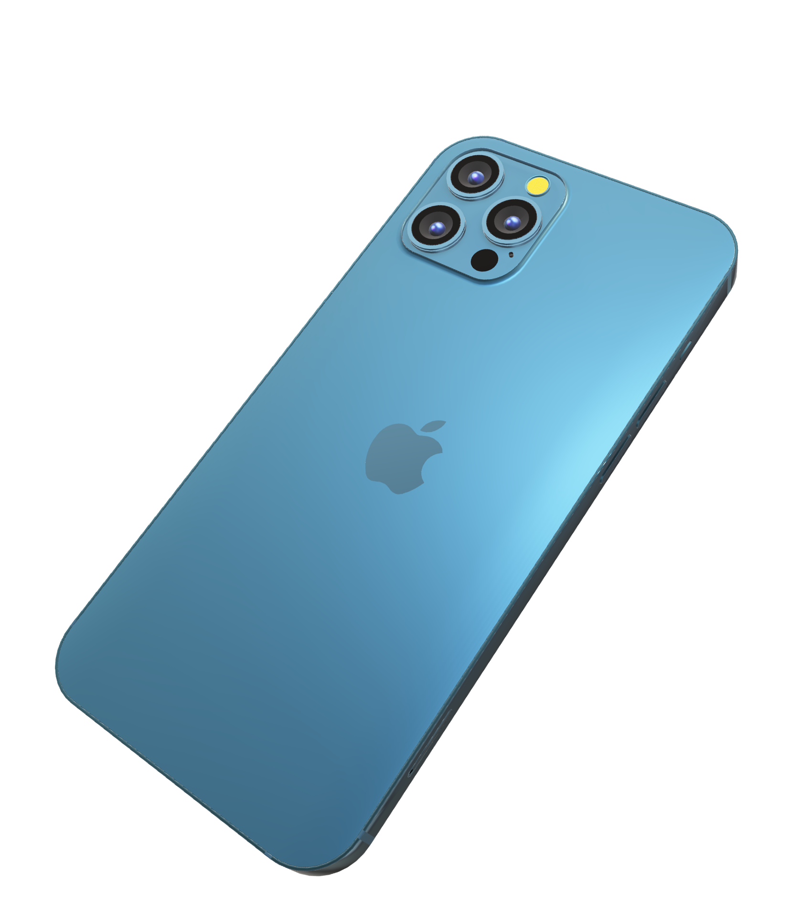
Charts & Filters
Notes:
These are the charts and filters I have used in the dashboard

Slide 11
Charts Used
TOP PICKED IPHONES
LOLIPOP CHART
STAR RATING BY NUMBER OF REVIEWS
BAR CHART
MODEL SPOTLIGHT
TABLE CHART
STAR RATING BY MODEL
TREEMAP CHART

Slide 12
Charts Used
RAM DISTRIBUTION
DONUT CHART
AVERAGE PRICE DISTRIBUTION BY MODEL
BAR CHART
IPHONE MODELS RAM STORAGE
FILTERS
DISCOUNT ALLOWED
PARAMETER [FILTER]

Slide 13
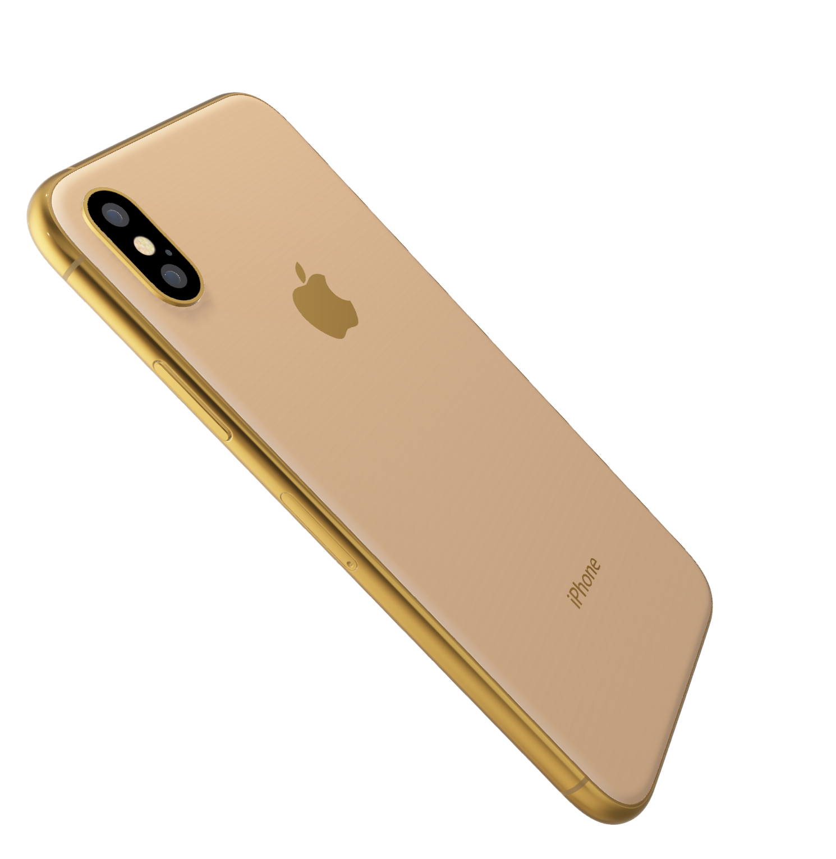
Dashboard
Notes:
This is the snapshot of dashboard created in tableau

Slide 14
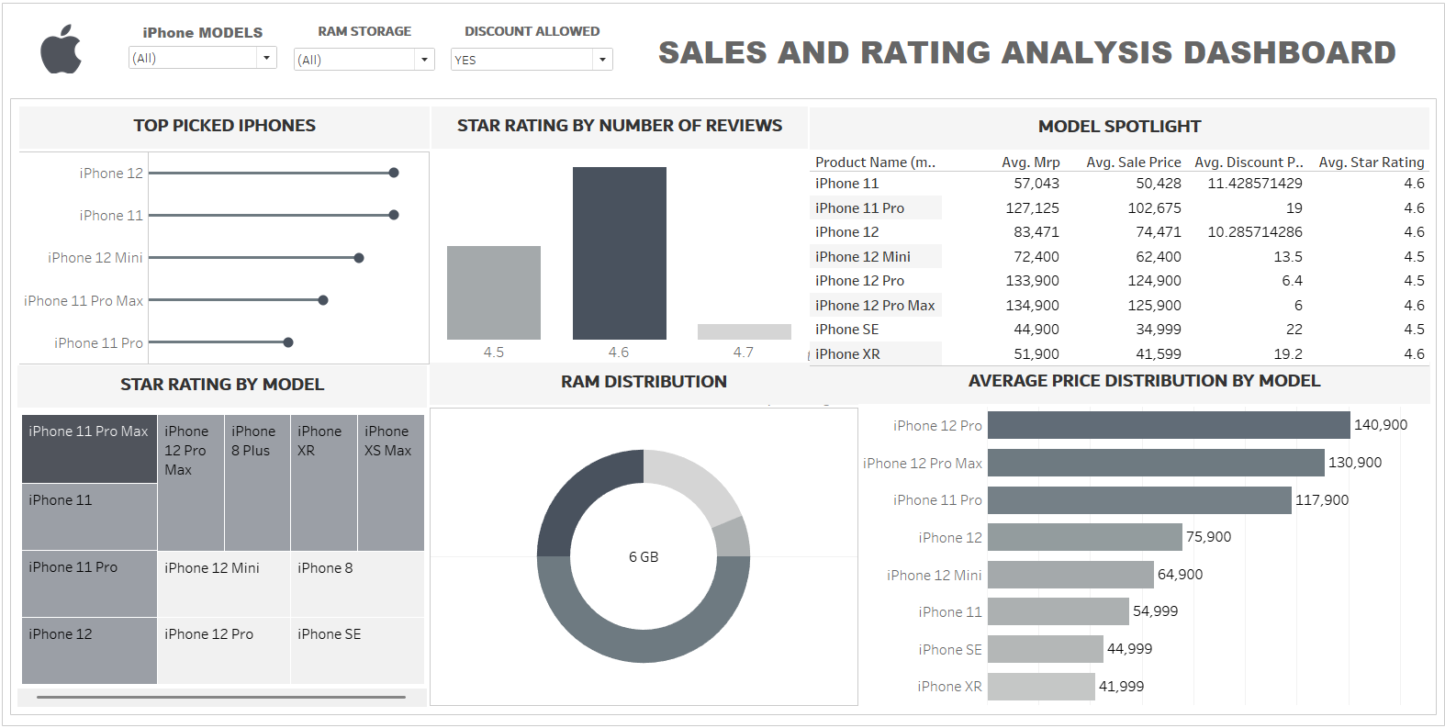
Dashboard
Notes:
TOP PICKED IPHONES – LOLIPOP, (PRODUCT NAME/COUNT OF STAR RATING)
STAR RATING BY NUMBER OF REVIEWS – VERTICAL BAR (STAR RATING /NUMBER OF REVIEWS)
MODEL SPOTLIGHT – TABLE (MODEL NAME HIGHLIGHTED)
STAR RATING BY MODEL – TREEMAP ( PRODUCT NAME/STAR RATING)
RAM DISTRIBUTION – DONUT (RAM SIZE/ MODEL NAME)
AVERAGE PRICE DISTRIBUTION BY MODEL – HORIZONTAL BAR (MODEL/MAX SALE PRICE)

Slide 15
POPULAR MODELS :
Most Popular – The iPhone 12
iPhone 11,
iPhone 12 Mini,
iPhone 11 Pro Max, iPhone 11
Findings
CUSTOMER SATISFACTION :
[4.7] – iPhone 11 Pro Max
[4.5] – iPhone 12 Mini , iPhone 12 Pro, iPhone 8,
iPhone SE
RAM DISTRIBUTION :
Mostly Used – 4 GB
Least Used – 3 GB
Notes:
POPULAR MODELS :
Most Popular – The iPhone 12
iPhone 11,
iPhone 12 Mini,
iPhone 11 Pro Max, iPhone 11
CUSTOMER SATISFACTION :
[4.7] – iPhone 11 Pro Max
[4.5] – iPhone 12 Mini , iPhone 12 Pro, iPhone 8,
iPhone SE
RAM DISTRIBUTION :
Mostly Used – 4 GB
Least Used – 3 GB

Slide 16
PRICE RANGE :
Premium Segment – (Discount)
iPhone 12 Pro
iPhone 12 Pro max
iPhone 11 Pro
Findings
PRICE RANGE :
Premium Segment – (No Discount)
iPhone 11 Pro Max
iPhone XS max
iPhone 8 Plus
iPhone 8
Notes:
PRICE RANGE :
Premium Segment – (Discount)
iPhone 12 Pro
iPhone 12 Pro max
iPhone 11 Pro
PRICE RANGE :
Premium Segment – (No Discount)
iPhone 11 Pro Max
iPhone XS max
iPhone 8 Plus
iPhone 8

Slide 17
ENHANCE CUSTOMER ENGAGEMENT:
Loyalty Programs
Customer Feedback Loop
Exclusive Offers
Improvements
STRENGTHEN MARKETING CAMPAIGNS:
Targeted Advertising
Social Media Presence
Influencer Collaboration
Notes:
Loyalty Programs: Introduce customer loyalty programs to reward repeat purchases.
Steps: Market research, program design, software integration, promotion.
Customer Feedback Loop: Collect and analyse customer feedback to continuously improve products.
Steps: Set up feedback channels, analyze data, implement improvements.
Exclusive Offers: Provide exclusive discounts or early access to loyal customers.
Steps: Identify target customers, create offers, communicate effectively.
---------------------------------
Targeted Advertising:Use data analytics to tailor ads to specific customer segments.
Steps: Audience analysis, ad creation, campaign launch.
Social Media Presence: Maintain active profiles and engage users on popular platforms.
Steps: Content planning, regular posting, user engagement.
Influencer Collaborations Partner with influencers to reach a broader audience.
Steps: Identify relevant influencers, negotiate collaborations, track performance.

Slide 18
IMPROVE PRODUCT AVAILABILITY:
Expand Distribution channels
Inventory Management
Localized Stock
Improvements
FOCUS ON CUSTOMER EXPERIENCE:
After Sales Support
Personalized Services
Warranty and Insurance Plan
Notes:
Expand Distribution Channels: Partner with additional retailers and online platforms to increase product availability.
Steps: Market analysis, partnership building, logistics setup.
Inventory Management: Optimize inventory levels to meet demand.
Steps: Implement inventory management systems, monitor stock levels.
Localized Stock:Maintain stock closer to demand locations.
Steps: Regional warehousing, stock allocation.
-----------------------------------
After-Sales Support Provide excellent support services post-purchase.
Steps: Train support staff, establish support channels.
Personalized Services: Offer tailored services to meet individual customer needs.
Steps: Customer data analysis, service personalization.
Warranty and Insurance Plans: Offer extended warranties and insurance plans.
Steps: Develop plans, communicate to customers.

Slide 19
OPTIMIZE PRICING STRATEGY
Dynamic Pricing
Bundle Offers
Seasonal Promotion
Improvements
INNOVATE AND DIFFERENTIATE
New Features
Eco-Friendly Options
Unique Selling Propositions (USP)
Notes:
Dynamic Pricing: Adjust prices based on demand and market conditions.
Steps: Implement pricing algorithms, monitor market trends.
Bundle Offers: Offer product bundles at a discount.
Steps: Bundle creation, pricing, promotion.
Seasonal Promotions: Run promotions during key seasons.
Steps: Plan promotions, set discounts, advertise.
----------------------------------------------------
New Features: Introduce innovative features in iPhones.
Steps: Research and development, testing, launch.
Eco-Friendly Options: Introduce eco-friendly product options to attract environmentally-conscious customers.
Steps: Source eco-friendly materials, redesign processes.
Unique Selling Propositions (USP): Highlight unique features that differentiate iPhones.
Steps: Identify USPs, market communication.

Slide 20
Conclusion
These strategic improvements will drive significant growth, enable sustainable expansion and success for Apple's iPhone lineup, ensuring a competitive edge and enhanced customer satisfaction.
IMPROVMENTS :
Customer Engagement
Marketing Campaigns
Product Availability
Customer Experience
Pricing Strategy
Innovation and Differentiation
Notes:
Customer Engagement:
Sales: Loyalty programs boost repeat purchases.
Growth: Increased customer retention.
Satisfaction: Stronger customer relationships.
Marketing Campaigns:
Sales: Targeted ads increase conversions.
Growth: Attract new customers.
Satisfaction: Engage customers with relevant content.
Product Availability:
Sales: Prevents lost sales by ensuring product availability.
Growth: Efficient supply chain supports expansion.
Satisfaction: Meets customer expectations.
Customer Experience:
Sales: Exceptional support encourages repeat business.
Growth: Satisfied customers promote the brand.
Satisfaction: Personalized services enhance experiences.
Pricing Strategy:
Sales: Dynamic pricing attracts price-sensitive customers.
Growth: Capture new market segments.
Satisfaction: Transparent pricing builds trust.
Innovation & Differentiation:
Sales: New features draw in customers.
Growth: Sustained innovation drives business.
Satisfaction: Eco-friendly options and unique features meet customer preferences.

Slide 21


Reference
APPLE – OFFICIAL SITE
www.apple.com/in
KAGGLE – DATASET
www.kaggle.com/datasets/komalkhetlani/apple-iphone-data
TABLEAU - VISUALISATION

Slide 22
Thank You
Inspired by Apple Inc.
Submitted by Abin Antony P J

